Slide 1
Explaining Machine Learning Models
with Interactive Natural Language Conversations Using TalkToModel
Authored by Dylan Slack, Satyapriya Krishna, Himabindu Lakkaraju, and Sameer Singh
Presented by Oam Patel, Jason Wang, and Lucas Monteiro Paes

Slide 2



Motivation
Simple and intuitive explanations for ML models is a bottleneck to adoption
Flexibility and accuracy tradeoff for inherently-interpretable models
Using post-hoc methods is difficult empirically (which explanations, how to interpret, follow-up questions, etc)

Slide 3
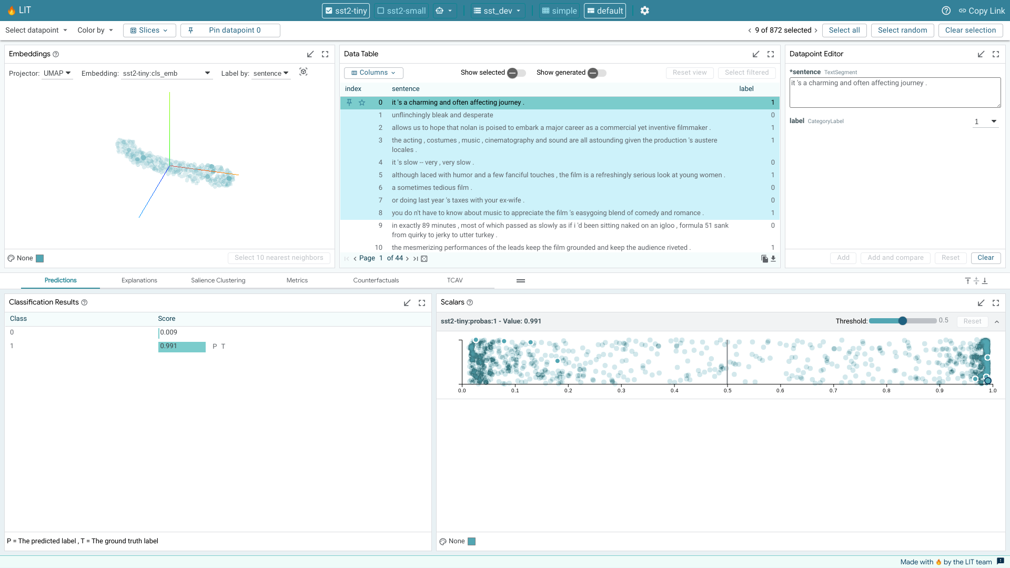
Related Work
Language-interpretability Tool (LiT)
Open-source platform for understanding NLP models
Uses local explanations (ala LIME), aggregate data statistics, and counterfactual explanations
“What-If” Tool
Helps users perform counterfactual analysis for models
explainerdashboard
Used as a baseline for experiments
Unfortunately, relatively high barrier to entry and no follow up questions

Slide 4
Problem Statement
Design a system that makes it easy for lay practitioners to apply post-hoc interpretability methods to black-box models
Desiderata
Dialogue system that can handle many conversation topics (general data trends, questions about specific predictions, etc)
Usable for a variety of data types and model classes (i.e. treatment prediction, risk of relapse, interest rate calculations, etc)
Doesn’t require a high level of expertise

Slide 5
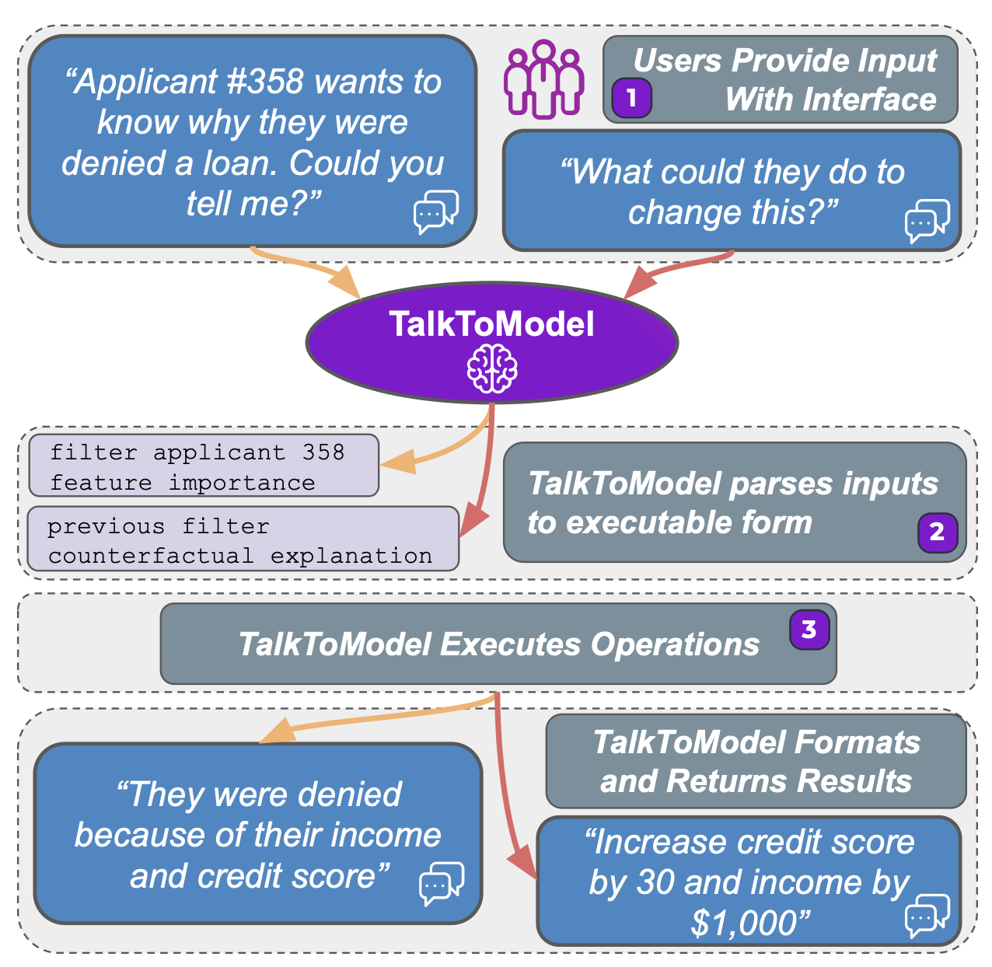
Summary of Contributions
Introduce TalkToModel which enables open-ended dialogue for understanding a given dataset+classifier pair
Why a prediction occurred, how it would change if data changed, how to flip predictions, general statistics regarding the data distribution, etc
Three parts
Dialogue engine (LLM backend)
Execution engine (run many explanations, pick the best one)
Text interface (to enable conversations)

Slide 6
Demo Time!

Slide 7
Method

Slide 8
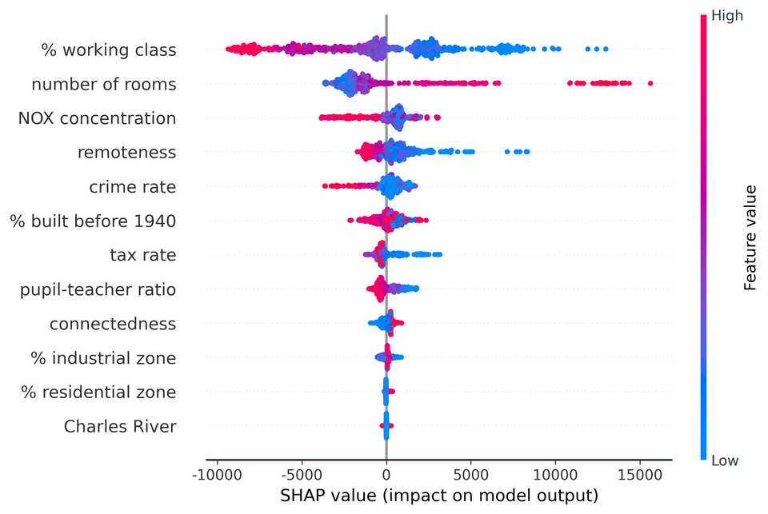
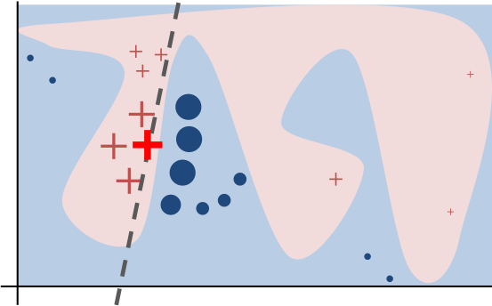
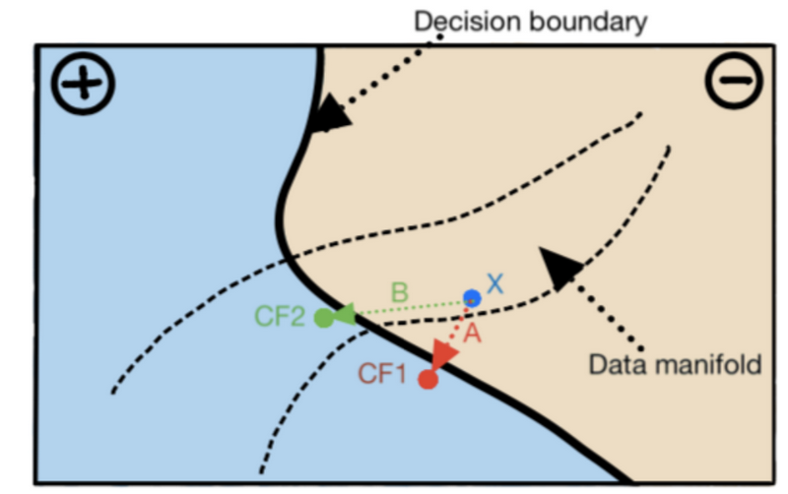
Background
SHAP Illustration
Lime Illustration
Counterfactual Illustration

Slide 9
Background
1 - Which one to choose for my application?
2 - Which one would a nurse\MD trust?
3 - How should a nurse\MD interpret the explanations?
4 - How would a nurse\MD use these methods?
5 - How would a nurse\MD interact with the method?
6 - …
SHAP Illustration
Lime Illustration
Counterfactual Illustration

Slide 10
Talking to Model
1 - It uses many (with the possibility to add more) post-hoc explanations!
2 - It chooses the “best” explanation to practitioner!
3 - It answer user’s questions with natural language!
4 - Users only need to provide the model and the data!
5 - They can communicate via natural language!
6 - …

Slide 11




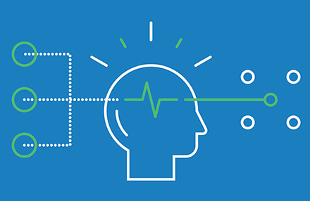

Method’s Structure

Slide 12
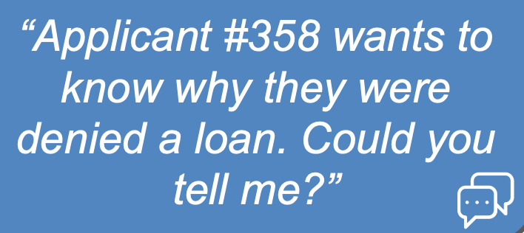
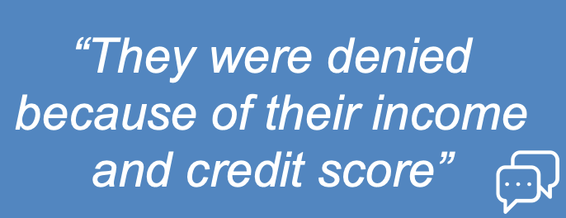
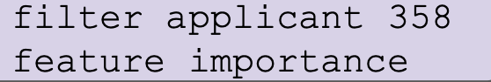
Method’s Structure

Slide 13
Method’s Structure
Dialogue engine
Structured Instructions
Human Query

Slide 14
Method’s Structure
Dialogue engine
Structured Instructions
Human Query
LLMs

Slide 15
Method’s Structure
Execution engine
Dialogue engine

Slide 16
Method’s Structure
Execution engine
Dialogue engine
Dialogue engine
Structured Result
Human Query

Slide 17
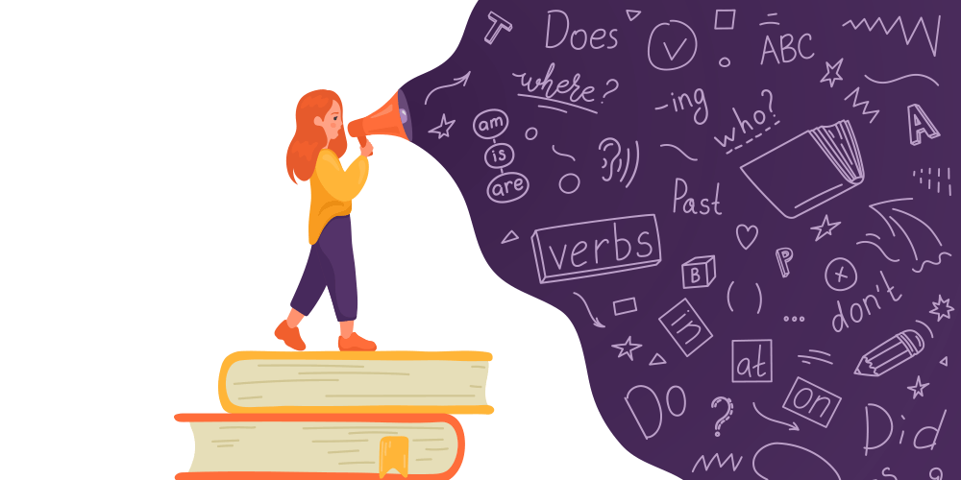
Dialogue Engine
“To represent the intentions behind the user utterances in a structured form, TalkToModel
relies on a grammar, defining a domain specific language for model understanding.”
Constructing a grammar

Slide 18
Dialogue Engine
How is the grammar generated?
There is a predefined grammar that depends on the production rules that includes:
1 - All the operations that TalkToModel can run,
2 - The arguments for each operation,
3 - The relations between operations!
Constructing a grammar

Slide 19

Dialogue Engine
How is the grammar generated?
How to define a grammar for different dataset?
There is a predefined grammar that depends on the production rules that includes:
1 - All the operations that TalkToModel can run,
2 - The arguments for each operation,
3 - The relations between operations!
It is a challenge to use a general grammar that works for all dataset.
Constructing a grammar
TalkToModel uses a grammar that is dependent on the dataset features!

Slide 20

Dialogue Engine
“To parse user utterances into the grammar, we finetune an LLM to translate utterances into the grammar in a seq2seq fashion”
Fine tuning LLM
Txt to Parses

Slide 21
Dialogue Engine
🤯
What is finetune?
“To parse user utterances into the grammar, we finetune an LLM to translate utterances into the grammar in a seq2seq fashion”
Fine tuning LLM
Txt to Parses

Slide 22
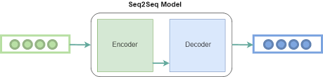
Dialogue Engine
“To parse user utterances into the grammar, we finetune an LLM to translate utterances into the grammar in a seq2seq fashion”
Fine tuning LLM
Txt to Parses
Sequence os itens.
User’s utterances
Sequence os itens.
Model’s grammar

Slide 23
Dialogue Engine
Few-shot GPT-J
Finetuned T5
“To parse user utterances into the grammar, we finetune an LLM to translate utterances into the grammar in a seq2seq fashion”
Fine tuning LLM
Txt to Parses
Sequence os itens.
User’s utterances
Sequence os itens.
Model’s grammar

Slide 24
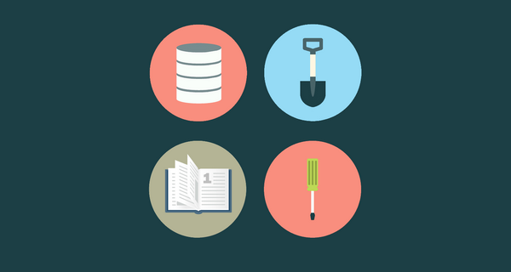
Dialogue Engine
How to generate fine tuning data?
Human annotation?
Generate fine tuning data

Slide 25
Dialogue Engine
How to generate fine tuning data?
Human annotation?
Generate fine tuning data

Slide 26
Dialogue Engine
How to generate fine tuning data?
1 - Write a initial set of user’s utterances and parses (where part of utterances & parses are wildcards terms).
2 - TalkToModel enumerates the wildcards with terms in the user’s provided data
Generate fine tuning data

Slide 27
Dialogue Engine
How to generate fine tuning data?
1 - Write a initial set of user’s utterances and parses (where part of utterances & parses are wildcards terms).
2 - TalkToModel enumerates the wildcards with terms in the user’s provided data
Generate fine tuning data
TalkToModel usually generates 20k to 40k pairs of parses.

Slide 28

Dialogue Engine
“After TalkToModel executes a parse, it composes the results of the operations
into a natural language response it returns to the user.”
Respond
conversationally

Slide 29
Dialogue Engine
TalkToModel generates responses using templates associated with each operation!
TalkToModel can run multiple operations at the same time. In this case, the model will join responses templates ensuring semantic coherence.
Respond
conversationally

Slide 30
Dialogue Engine
Constructing a grammar
Generate fine tuning data
Fine tuning LLM
Txt to Parses
Respond
conversationally

Slide 31
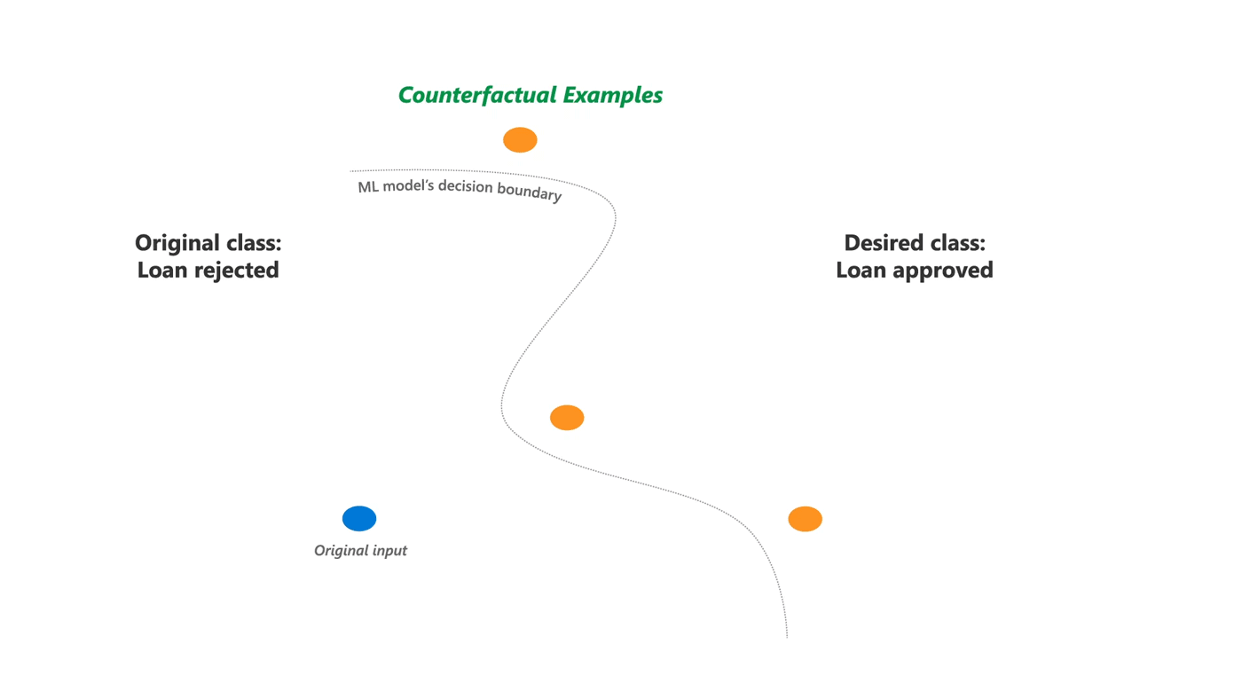
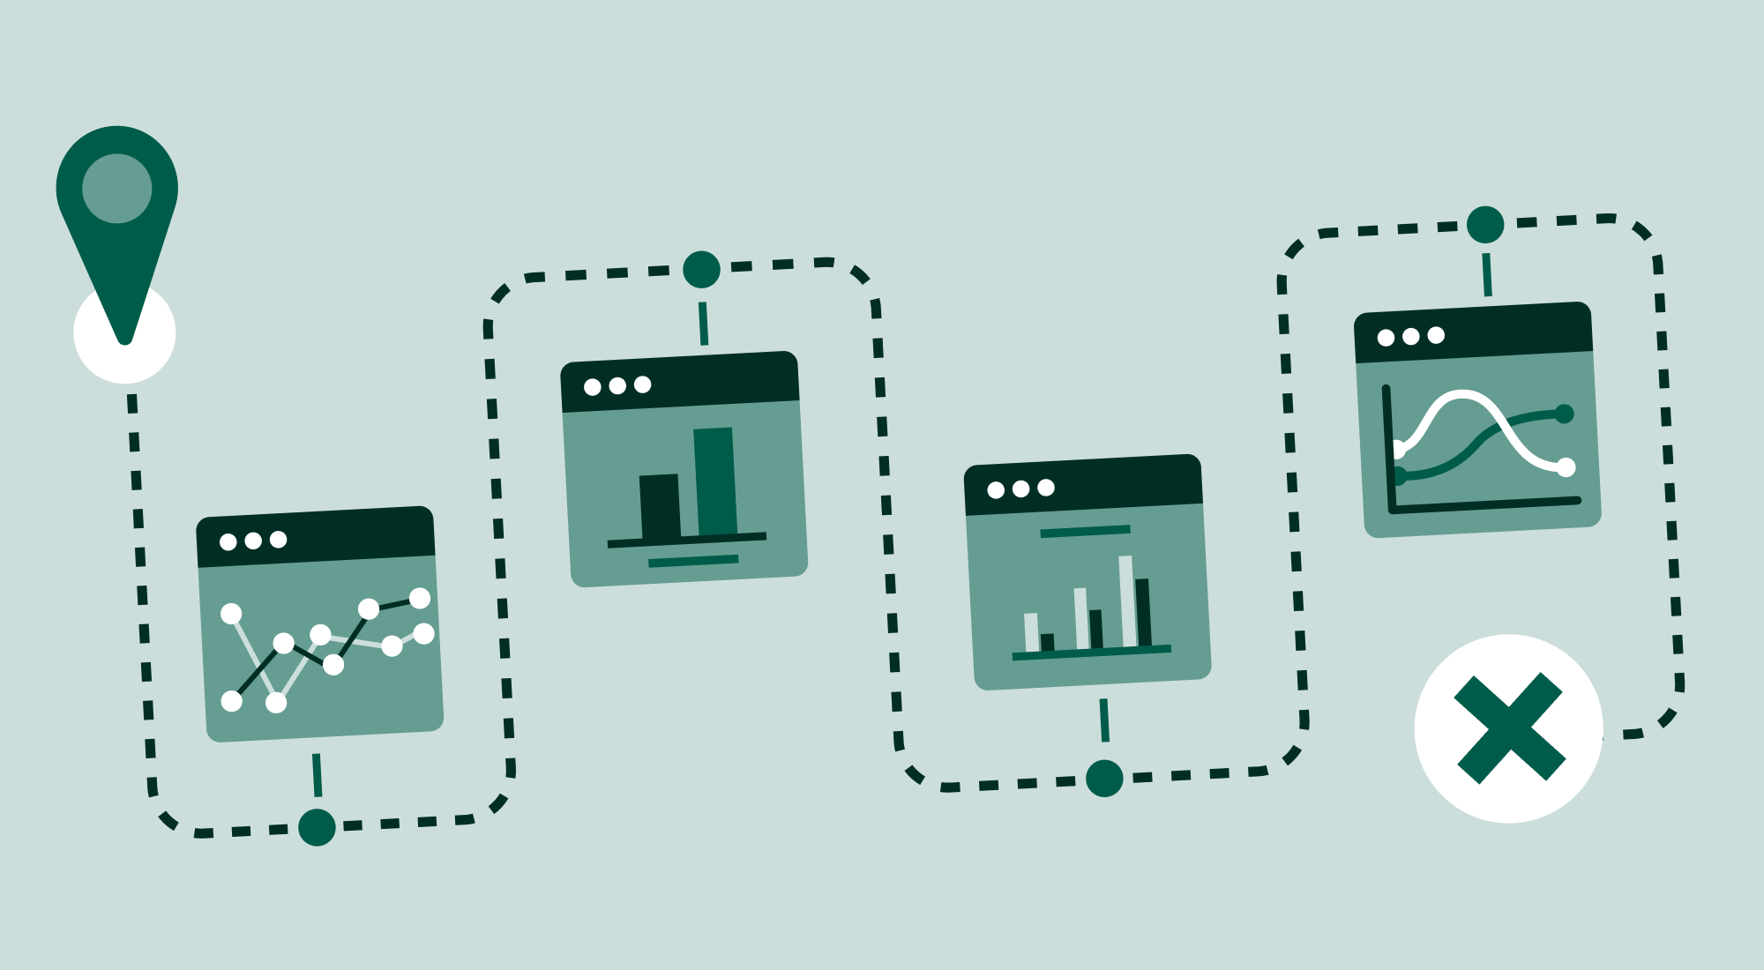
Execution Engine
Counterfactual Explanations:
TalkToModel uses DiCE because it provides a diverse set of counterfactuals.
Data and Predictions Exploration
TalkToModel allow users to analyse predictions, inspect the model for errors, and analyse de data itself.
Post-hoc Feature Explanations
TalkToModel uses LIME and SHAP to make feature importance based explanations.

Slide 32
Execution Engine
TalkToModel selects the best explanation!
Instead of providing the LIME coefficients or the SHAP values, the model test the methods and provide the “best” feature based explanation.
Counterfactual Explanations:
TalkToModel uses DiCE because it provides a diverse set of counterfactuals.
Data and Predictions Exploration
TalkToModel allow users to analyse predictions, inspect the model for errors, and analyse de data itself.
Post-hoc Feature Explanations
TalkToModel uses LIME and SHAP to make feature importance based explanations.

Slide 33
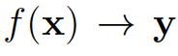
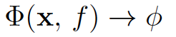
Execution Engine
How to select the best explanation?
Setup:
Is the model outputting the probability (y) of a class.
Feature importances for model f on the data x. greater magnitudes correspond to higher importance features
Explanation Selection

Slide 34
Execution Engine
How to select the best explanation?
How to choose the “best” feature importance?
Setup:
Is the model outputting the probability (y) of a class.
Small feature perturbations
lead to
Big score perturbations
More Important
Feature importances for model f on the data x. greater magnitudes correspond to higher importance features
Explanation Selection

Slide 35
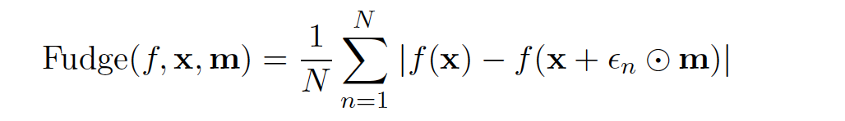
Execution Engine
How to select the best explanation?
Perturbed features are given by m
Gaussian Noise
The Fudge score!
original
prediction
Explanation Selection
perturbed prediction

Slide 36
Execution Engine
How to select the best explanation?
The Fudge score!
Magnitude of perturbation
by adding feature noise
Explanation Selection

Slide 37
Execution Engine
How to select the best explanation?
The Fudge score!
Average Magnitude of perturbations
by adding feature noise
Explanation Selection

Slide 38
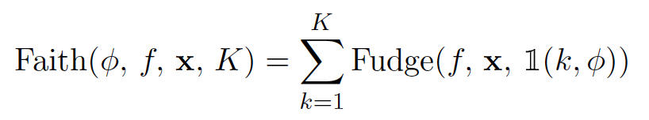
Execution Engine
How to select the best explanation?
The Fudge score
Feature Importance Faith
Explanation Selection
Indicator of top k features

Slide 39
Execution Engine
How to select the best explanation?
The Fudge score
Feature Importance Faith
Explanation Selection
Fudge Score of top k features

Slide 40
Execution Engine
How to select the best explanation?
The Fudge score
Choose the BEST
TalkToModel computes the faithfulness of:
LIME with kernels [0.25, 0.5, 0.75, 1.0]
KernelSHAP
Feature Importance Faith
Explanation Selection
Report the one with highest faith!

Slide 41
Results

Slide 42
Summary of Experiments
2. Grammar Experiment
3. User Experiment
1. LLM Experiment
Execution engine
Dialogue engine
Dialogue engine

Slide 43
1. LLM Experiment
Is the LLM accurately interpreting the user’s question?
Create a “Gold Dataset” - ground truth (utterance, parse) pairs specific to one application domain
Evaluate “Exact Match Accuracy” of LLM translation

Slide 44
1. LLM Experiment
Is the LLM accurately interpreting the user’s question?
Create a “Gold Dataset” - ground truth (utterance, parse) pairs specific to one application domain
Evaluate “Exact Match Accuracy” of LLM translation
Compare along easy and hard splits of the data
Compare along n-shot and fine-tuning for different LLM sizes

Slide 45

Data Collection
Authors handwrote 50 (utterance, parse) pairs for each domain
Enforce that every operation appears at least twice for good coverage

Slide 46


Data Collection
MTurk
Authors handwrote 50 (utterance, parse) pairs for each domain
Enforce that every operation appears at least twice for good coverage
Use MTurk to paraphrase utterances in 8 different ways
For a total of 400

Slide 47


Data Collection
MTurk
MTurk
Authors handwrote 50 (utterance, parse) pairs for each domain
Enforce that every operation appears at least twice for good coverage
Use MTurk to paraphrase utterances in 8 different ways
For a total of 400
Use MTurk to rate fidelity of paraphrase to original utterance
Keep those that rate 3/4 or higher averaged over 5 raters

Slide 48
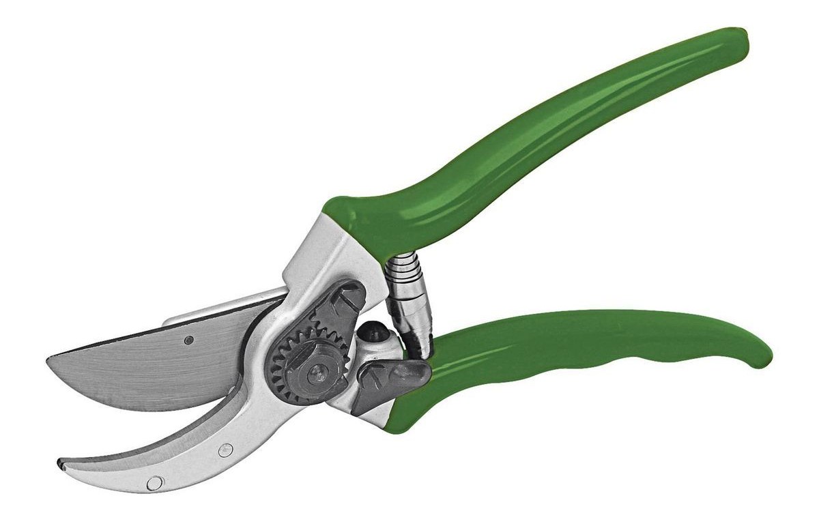

Data Collection
Authors
MTurk
MTurk
Authors handwrote 50 (utterance, parse) pairs for each domain
Enforce that every operation appears at least twice for good coverage
Use MTurk to paraphrase utterances in 8 different ways
For a total of 400
Use MTurk to rate fidelity of paraphrase to original utterance
Keep those that rate 3/4 or higher averaged over 5 raters
Manual Filtering by Authors
Unclear (in paper) what proportion of filtering is done by MTurk vs. Authors

Slide 49
Example Paraphrases from TTM’s Open Source Data
“What is your reasoning for determining if people older than 20 are likely to commit crimes?”

Slide 50
Example Paraphrases from TTM’s Open Source Data
“What is your reasoning for determining if people older than 20 are likely to commit crimes?”
“Why do you think people over the age of twenty are likely to commit a crime?”
“How did you determine the likelihood of people over 20 committing crimes?”
“Can you reason why people over twenty would likely commit crimes?”
4 4 4 3 3
2 4 3 4 4
3 2 4 3 2

Slide 51

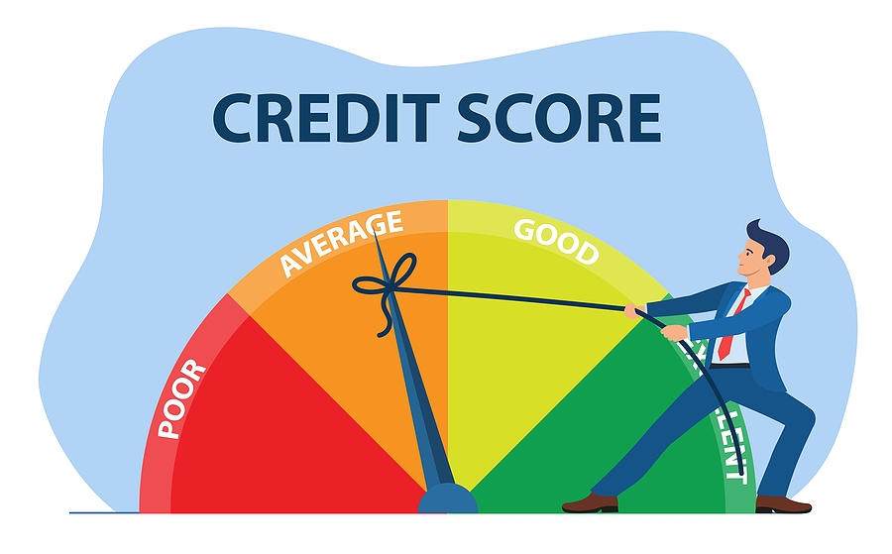

Domains/Datasets
Diabetes: Pima Indian Diabetes Dataset
768 Women from Phoenix, AZ
8 Health Features, Diabetes or Not
Questions: 400 → 190
Credit: German Credit Dataset
1000 Loan Applicants
20 Financial Features, Good or Bad
Questions: 400 → 200
Recidivism: COMPAS
11757 Men and Women Criminal Defendants
43 Demographic/History Features, Risk Score 1-10
Questions: 400 → 146

Slide 52
Domains/Datasets
Diabetes: Pima Indian Diabetes Dataset
768 Women from Phoenix, AZ
8 Health Features, Diabetes or Not
Questions: 400 → 190
Credit: German Credit Dataset
1000 Loan Applicants
20 Financial Features, Good or Bad
Questions: 400 → 200
Recidivism: COMPAS
11757 Men and Women Criminal Defendants
43 Demographic/History Features, Risk Score 1-10
Questions: 400 → 146

Slide 53

Splits of the Gold Dataset
IID (Easy)
Order of operations are in the training data
Allowing different arguments
Compositional (Hard)
Order of operations not seen before in the training dataset

Slide 54
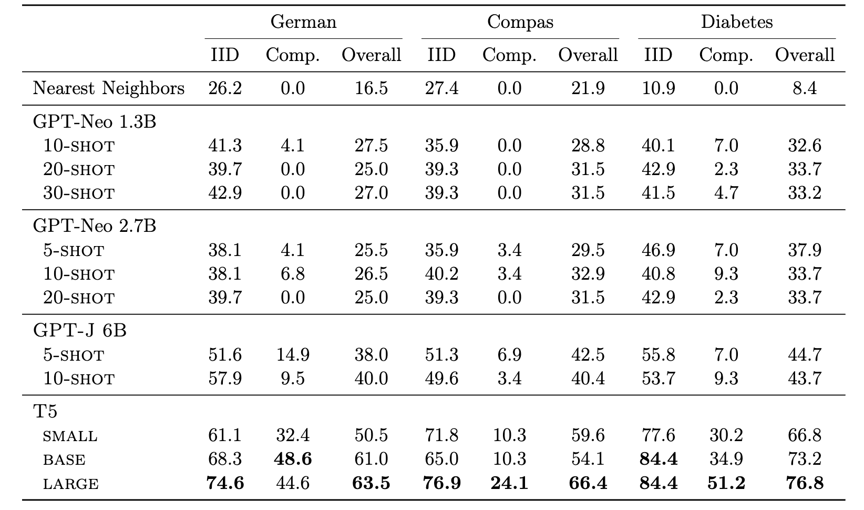

Slide 57
2. Grammar Experiment
Is the grammar expressive enough to capture all XAI questions?
Use an XAI question bank
Previous work, informed by design expert interviews
Manually review if grammar can answer questions
30/31 questions can be answered!
More questions deemed out of scope

Slide 58
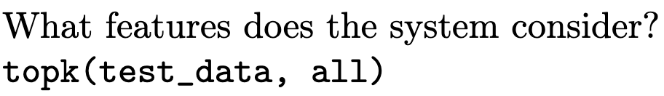
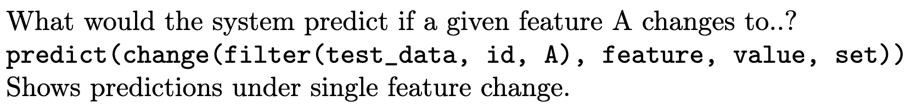
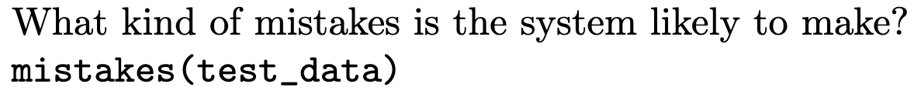
2. Grammar Experiment
Is the grammar expressive enough to capture all XAI questions?
Use an XAI question bank
Previous work, informed by design expert interviews
Manually review if grammar can answer questions
30/31 questions can be answered!
More questions deemed out of scope

Slide 59
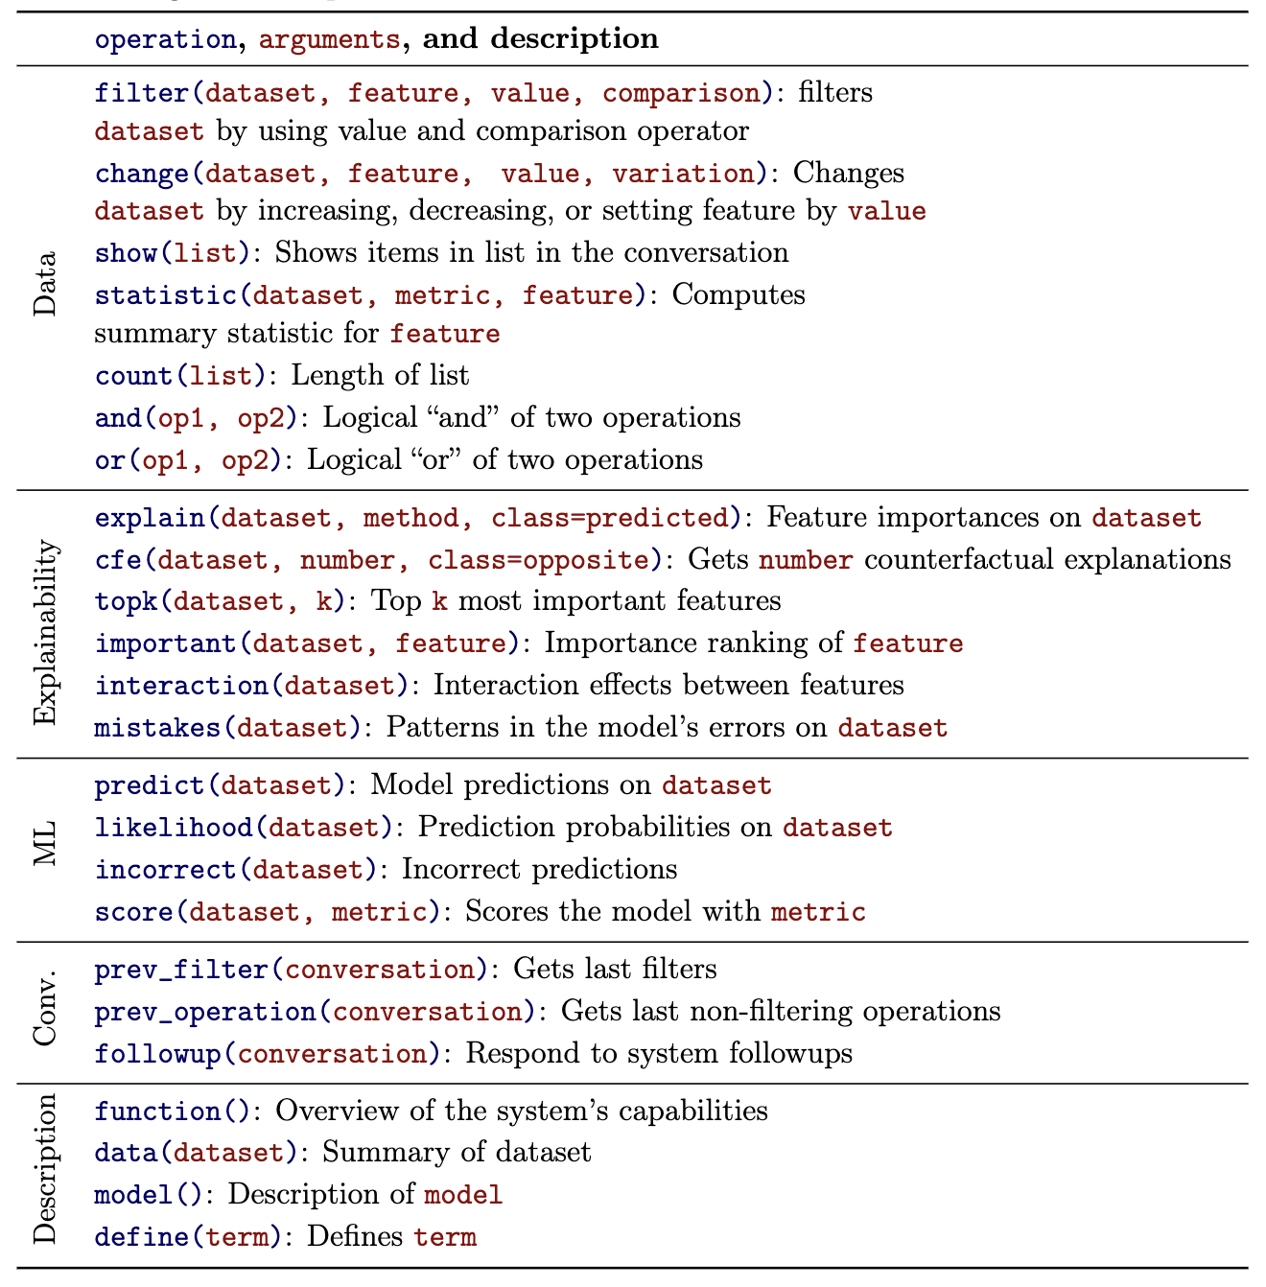

Slide 60
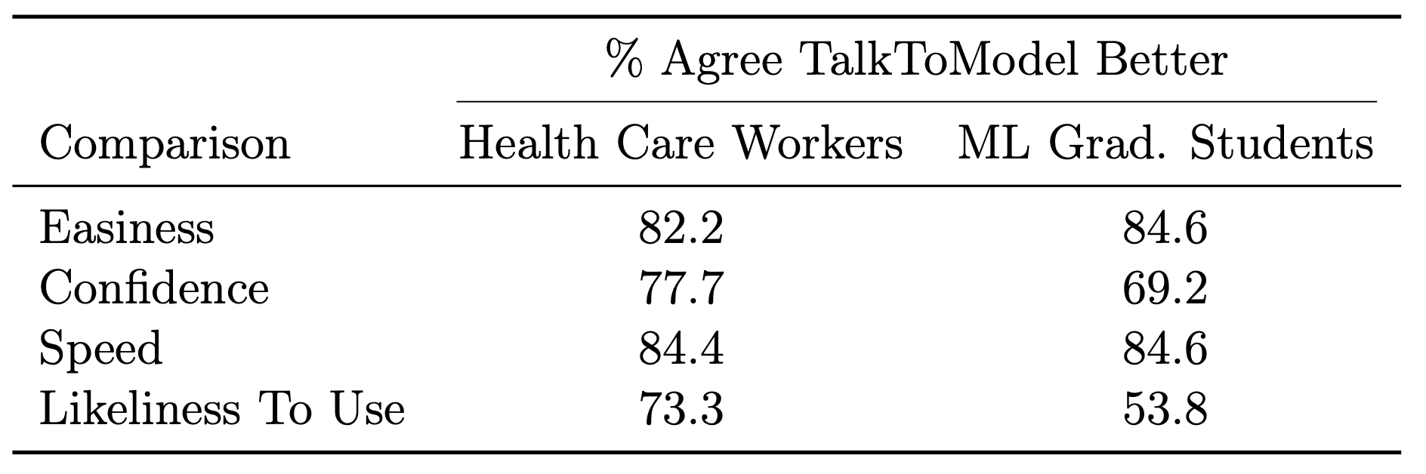
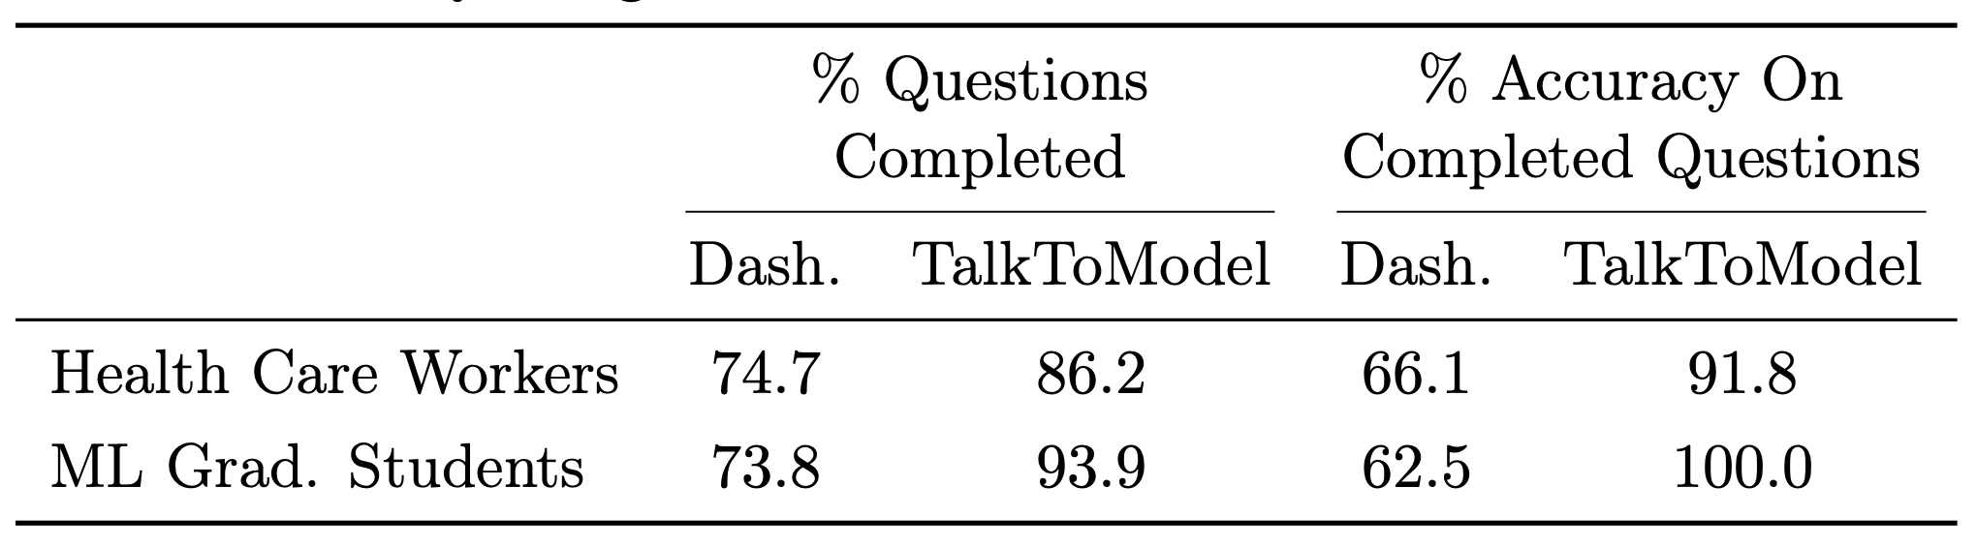
3. User Experiment
Example question: “Is glucose more important than age for the model’s predictions for data point 49?”
Diabetes dataset with a gradient-boosted tree model
45 healthcare workers; 12 ML grads
Answer 10 XAI MC questions
Survey user preference vs. explainerdashboard
Ease of use, confidence, speed, and likability

Slide 61
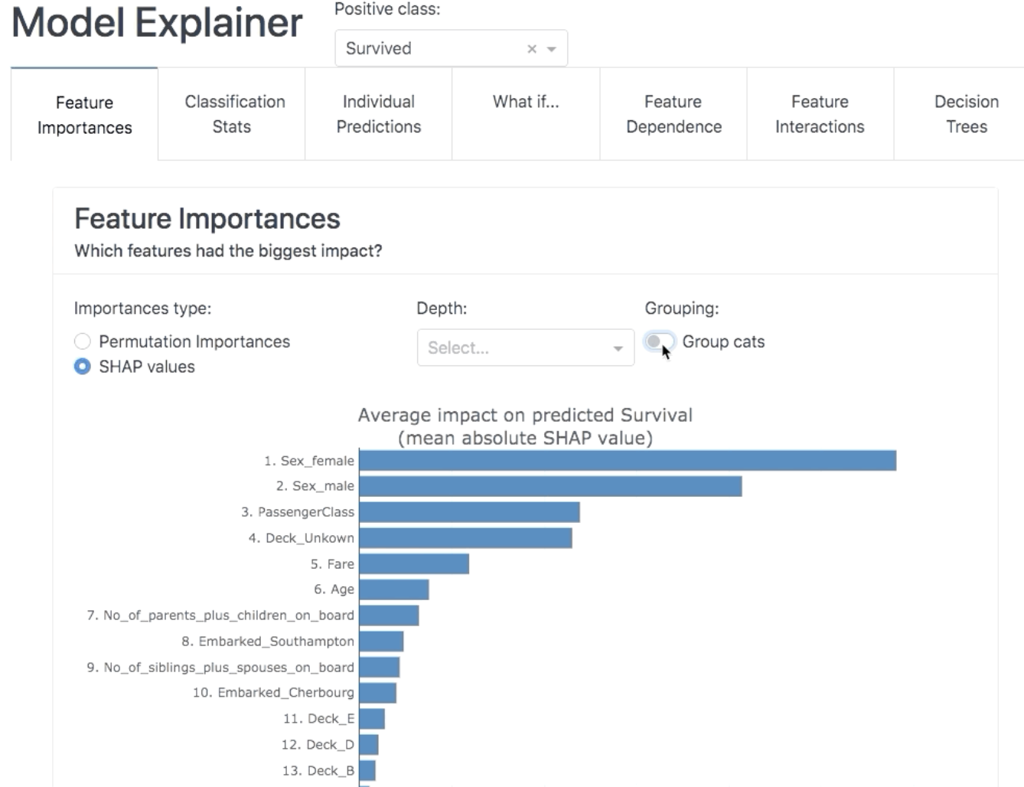
explainerdashboard

Slide 62
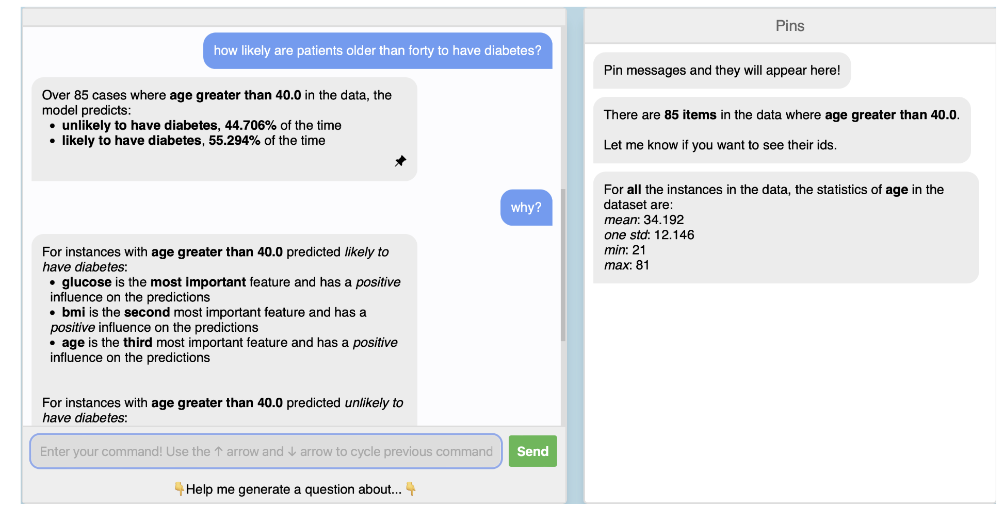
TalkToModel

Slide 63

Findings
Users using TalkToModel (as compared to explainerdashboard)
Over 90% accurate compared to 60% otherwise
Got answers in half the time
Consistently preferred it on ease of use, confidence, speed, and likability

Slide 64

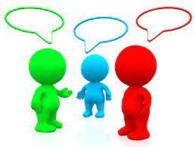
Conclusions
TalkToModel provides an elegant UI and conversation tool that makes interpreting models easier for laypeople and ML practitioners alike
Highly extensible to handle a variety of explainability needs, problem domains, and XAI methods
Reasonably accurate at interpreting user intent and provides well-formatted templated responses
A dataset of your own is all you need to use TalkToModel

Slide 65

Limitations
Authors do not test the system in real world settings
Automation of explainability methods gives no flexibility on user side (e.g., “what is the most feasible CFE” or “what is the most stable post-hoc explanation”)
No guarantees on data quality for both training and fine-tuning, and still requires some manual labor
System possesses no domain knowledge besides grammar
Accuracy on hard split is still very low

Slide 66

Discussion Questions
Are ML practitioners the most responsible for accessibility of XAI?
Is the TalkToModel LLM itself interpretable?
When is it acceptable to improve XAI with more black box AI?
How much control over the explanation should we give to the user while still being accessible to the layperson?
Does the existence of TalkToModel excuse the need for other XAI methods to be accessible?
Dashboard vs. Dialogue?

